Slide 1

课时练习
模块六 第二章 读写综合训练

Slide 2
一、完形填空。
On my first job, I worked as a sports editor(编辑) for a small newspaper. I never got a letter from my readers, so I was 1 when I saw an envelope(信封) on my desk one morning. From the envelope, I could see it was from a most popular newspaper.
When I opened it, I found a 2 and it read, “You did a good job. Go on!”
1. A. sad B. afraid C. surprised
2. A. note B. book C. letter
C
A

Slide 3
一、完形填空。
The note was from Mr. John, a famous sports editor. As I was a green hand, his words made me 3 . After that, I kept the note in my desk drawer. Whenever I doubted(怀疑) if I could be a good editor, I would read John’s note and become 4 again.
3. A. sick B. excited C. unhappy
4. A. strict B. serious C. confident
B
C

Slide 4
一、完形填空。
Later, when I made friends with Mr. John, the note 5 , I learned that he often wrote notes to encourage(鼓励) young people. “When I make others feel happy,” he told me, “I feel happy, too.”
6 , why are there few kind men like John in our life? I think it’s because many people are afraid that they cannot be well understood.
5. A. writer B. finder C. buyer
6. A. But B. However C. Though
A
B

Slide 5
一、完形填空。
B
Also, writing takes more time and it is 7 to pick up the phone. The 8 with phone calls is that they cannot last a long time, but a note can be read again and again.
7. A. harder B. easier C. stronger
8. A. problem B. question C. reason
A

Slide 6
一、完形填空。
C
So, 9 you find some people around you need help, please write a note of encouragement to bring them confidence. Maybe, you are not sure what will happen, but remember Mr. John’s words—to give others happiness is to give 10 happiness.
9. A. before B. until C. when
10. A. yourself B. themselves C. himself
A

Slide 7
二、阅读理解。
One day, Mike and Nick decided to take their holiday in Australia. Their plane arrived in Sydney at nine in the morning. Then they had a good rest in a nice hotel.
The next morning they rented a car in the city and began their trip. A few hours later the sun was shining in the sky and there were no shade(遮阴) trees beside the road. It was so hot that they could hardly go on driving. They had to stop to look around.

Slide 8
二、阅读理解。
Soon Mike was happy to find that a river was about half a kilometer away from them. They restarted the engine(引擎) at once and drove the car quickly. Soon they got to the river. Before they jumped into the river, Nick saw a boy playing under a big tree. He went up to the boy and asked, “Are there any sharks(鲨鱼) in the river?” “No,” answered the boy, “There aren’t any.”

Slide 9
二、阅读理解。
Then they began to swim in the river. But after a while, Nick felt something hit against his leg. He told Mike about it. They were very afraid and stopped swimming. Nick shouted at the boy loudly, “Is it true that there are not any sharks in the river?” “Yes, Sir. There are a lot of crocodiles(鳄鱼) in the water. The sharks all swam away.”

Slide 10
二、阅读理解。
( )1. Mike and Nick went to Australia _____.
A. by sea B. by air
C. by land D. by car
B

Slide 11
二、阅读理解。
( )2. The two young men went to Australia to ___.
A. swim in the river
B. learn to drive
C. go on holiday
D. visit their friends
C

Slide 12
二、阅读理解。
( )3. Mike and Nick couldn’t go on driving because ____.
A. the wind was too strong
B. the car broke down
C. the weather was very hot
D. they were too tired
C

Slide 13
二、阅读理解。
( )4. The underlined word “it” in Paragraph 3 refers to ____.
A. a shark in the water
B. a crocodile in the water
C. something hitting against Nick’s leg
D. the boy laughing at them
C

Slide 14
二、阅读理解。
( )5. How may Nick and Mike feel after hearing what the boy said in Paragraph 3?
A. Angry. B. Surprised.
C. Glad. D. Sad.
A

Slide 15
三、短文填空。
Have you ever been to Ireland(爱尔兰岛)? If not, you should think of 1 (spend) a vacation there. The Republic of Ireland (referred to as “Ireland”) 2 in the south of the island. There are about 4.94 million people in the country. The 3 is quite wet and warm. Falls of snow in Ireland are most unusual.
spending
lies/is
weather

Slide 16
三、短文填空。
Ireland is full of interesting things to do. You’ll find restaurants and cafes(咖啡馆) 4 . /ˈevriweə(r)/. Most of them have a long list of Irish food and drinks. After your meal, you can take 5 walk along the shore(海岸). You may also want to try sports like sailing, boating, swimming, fishing and golfing. Besides, Ireland is 6 /ˈfeɪməs/ for its theaters and festivals. So why don’t you stay longer for a party, an opera or a concert?
everywhere
a
famous

Slide 17
三、短文填空。
friendly
The Irish people are kind and 7 (friend). From mountains to beaches you’ll find people ready to stop and talk about the local geography or history and maybe about what you should see next. The Irish people have kept their own 8 /ˈkʌltʃə/ of music and literature(文学) well.
culture

Slide 18
三、短文填空。
Different areas have different kinds of music. In towns and villages, people get together in the evening to sing and play music. They also get together to read 9 (poem) to each other. Meeting such people is 10 (real) fun, isn’t it?
poems
really

Slide 19
四、书面表达。
上个星期六（10月9日）， 你和朋友一起坐公交车去福州森林公园（Fuzhou Forest Park）游玩。请根据以下思维导图的提示用英语写一篇日记， 叙述你这一天的经历。（70个词左右， 日记开头已给出， 不计入总词数）

Slide 20
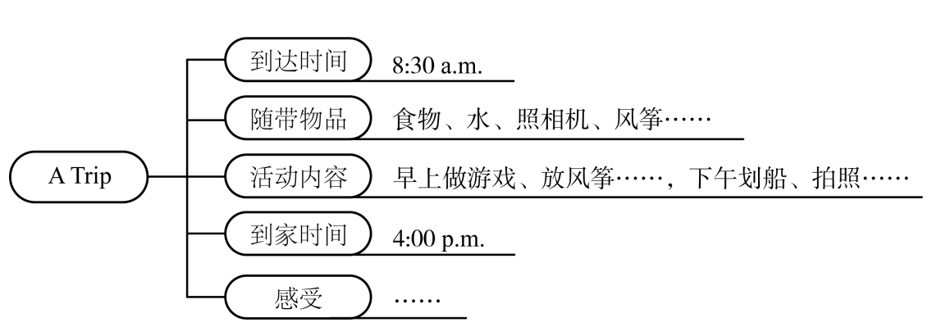
四、书面表达。

Slide 21
四、书面表达。
Saturday, October 9th
Today I went to Fuzhou Forest Park for a trip with my friends.
We got there by bus at about 8:30 in the morning. We took some food, water, a camera and a kite there. In the morning, my friends and I played games and flew a kite. We had lunch on the grass at about 12:00. After lunch, we went boating on the lake and we took many beautiful photos. We didn’t go home until 4:00 p.m. We felt tired but happy.

Slide 22


